Slide 1


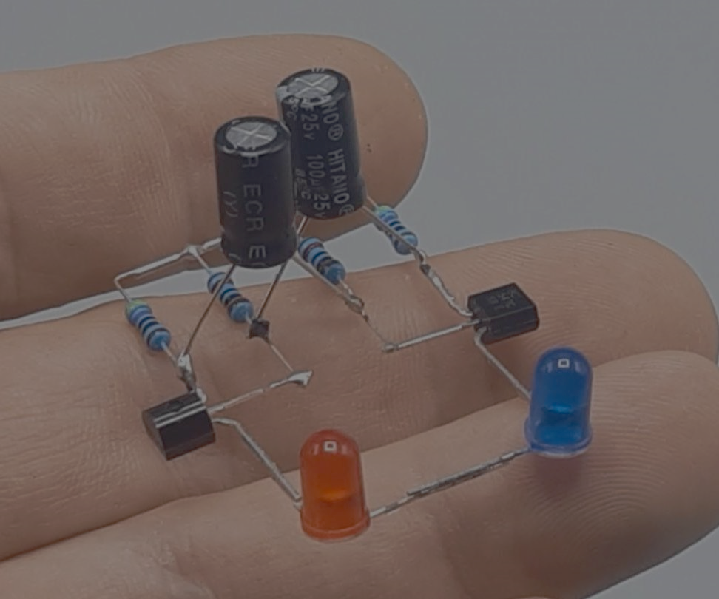


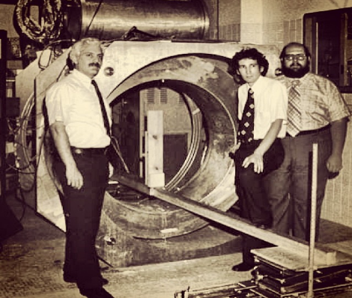




PITCH DECK
BEYOND LEVEL O
VIT Bhopal Student chapter

Slide 2

TEAM ENIGMA
(The Student Connect)
Theme- Tech for Social Good
MEMBER
MEMBER
MEMBER
MEMBER
1
2
3
4
K.DINKAR
22BSA10189
Manikandan K
22BSA10025
ANTARIKSH SARMAH
22BCY10168
Shivam
22BAI10342
CSE SPECIALIZATION IN
CLOUD
COMPUTING
CSE SPECIALIZATION IN
CLOUD COMPUTING
CSE SPECIALIZATION IN
CYBER
SECURITY
CSE SPECIALIZATION IN
ARTIFICIAL INTELLIGENCE

Slide 3
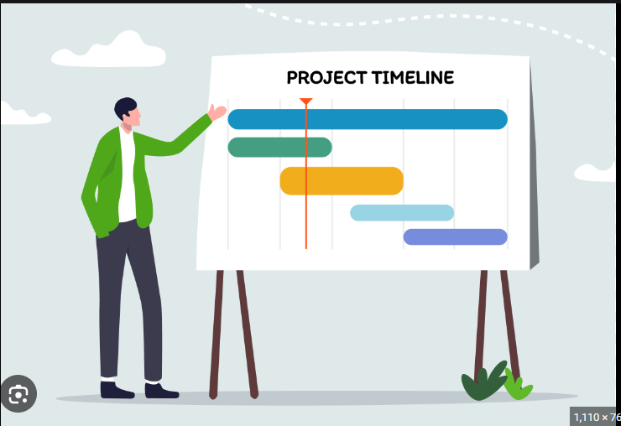

Timeline of Our Project
Problem statement
Solution
Feasibility

Slide 4



Problem statement
Kothri: A case Study of Day-Scholars
Kothri surrounds the immediate vicinity of VIT-B Campus and approx. 200 students live here.
Lack of options or proper means to avail meal services for Day Scholars.
Absence of Online Delivery Services.
No Integrated Platform for ordering from multiple sources.
Self-Dependence not always an option for students.
Weather Variables disrupt eating habits.
Manually ordering from different sources can be cumbersome.
No Guarantee of Prioritizing Orders.
Food Wastage due to abandoned orders.

Slide 5
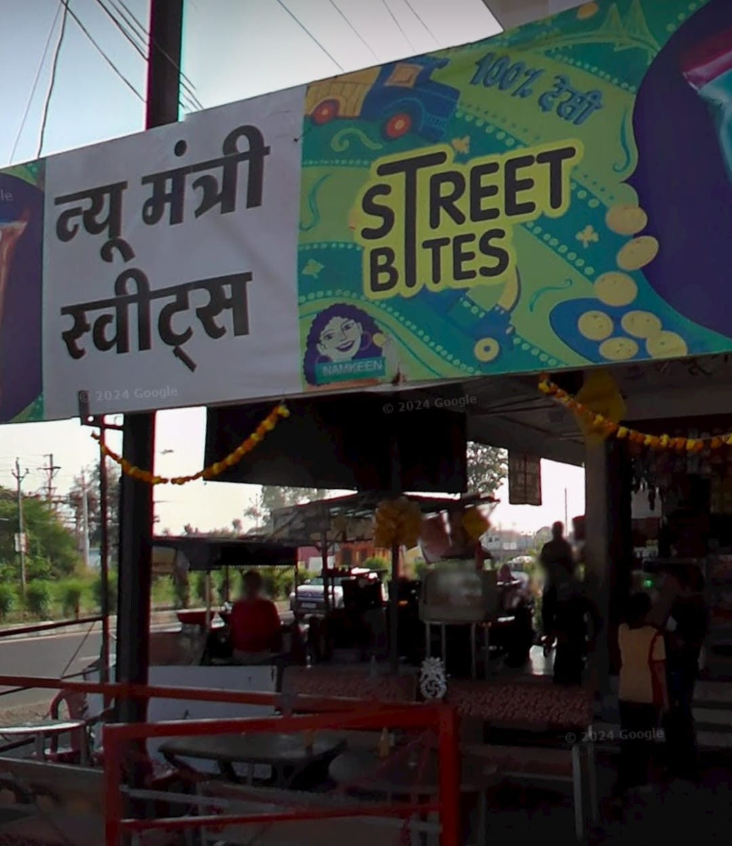
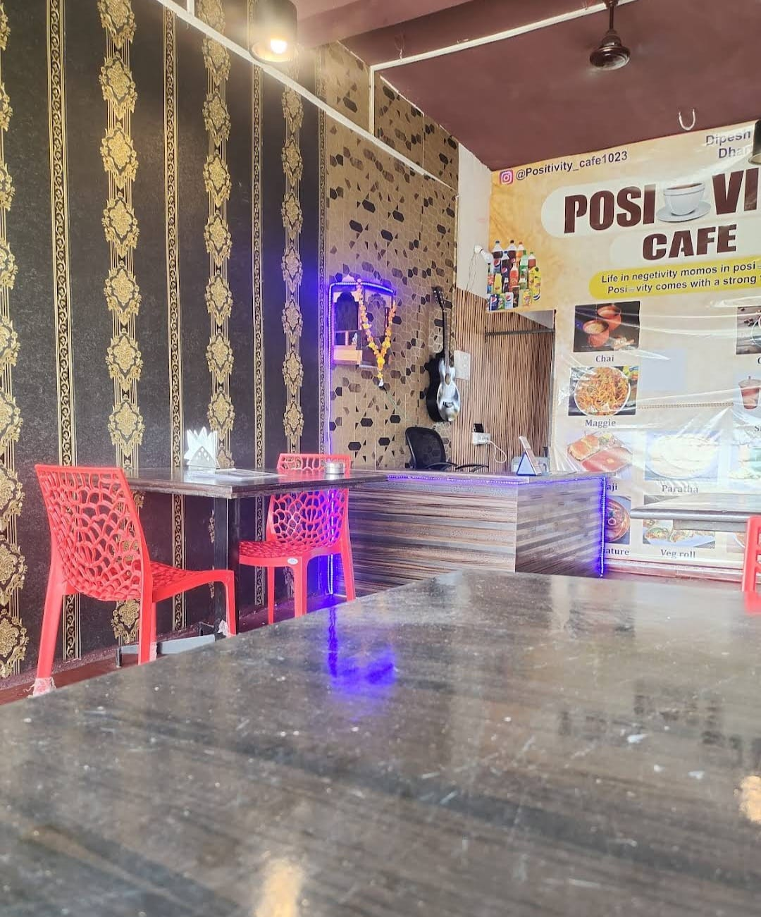
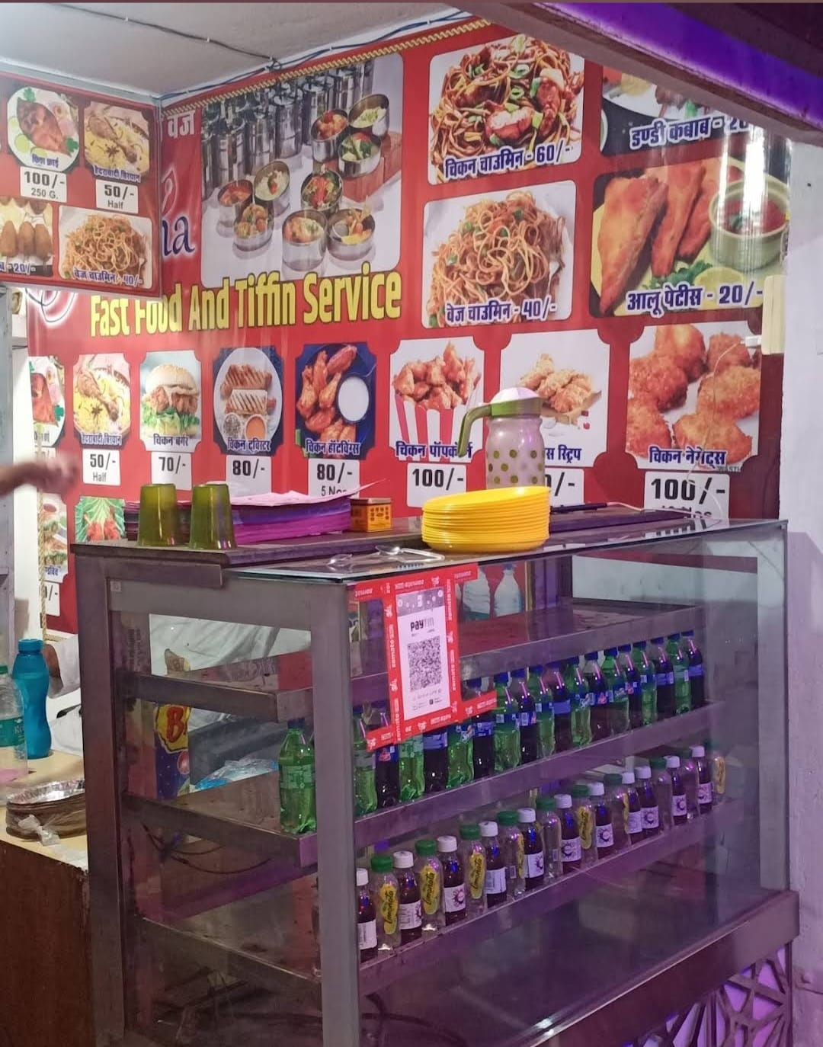
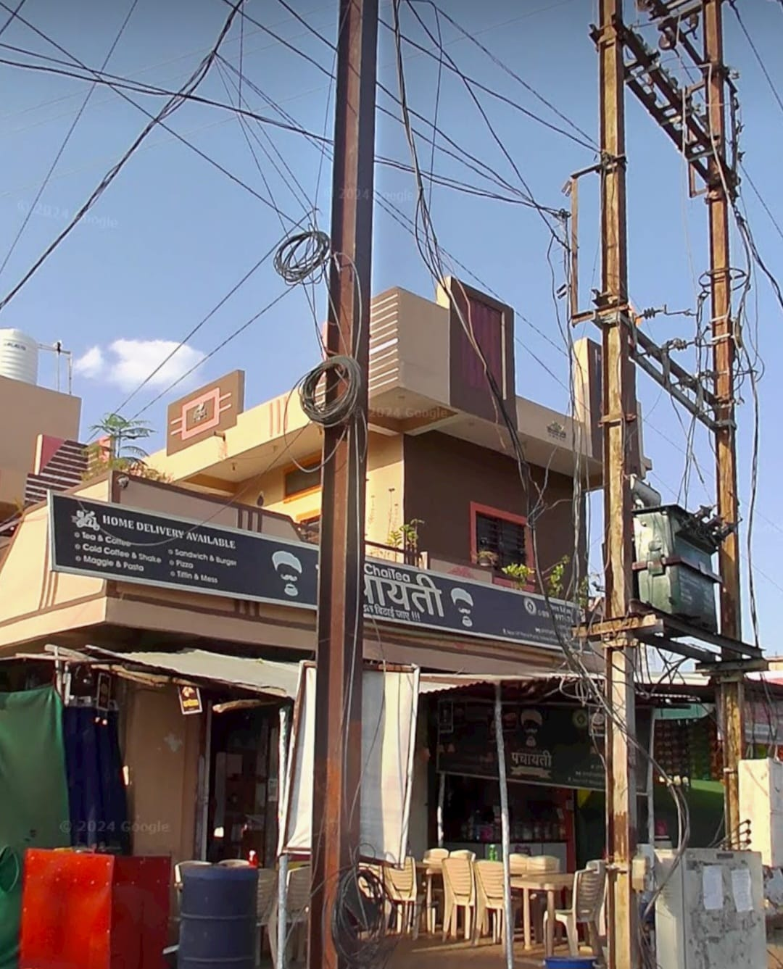
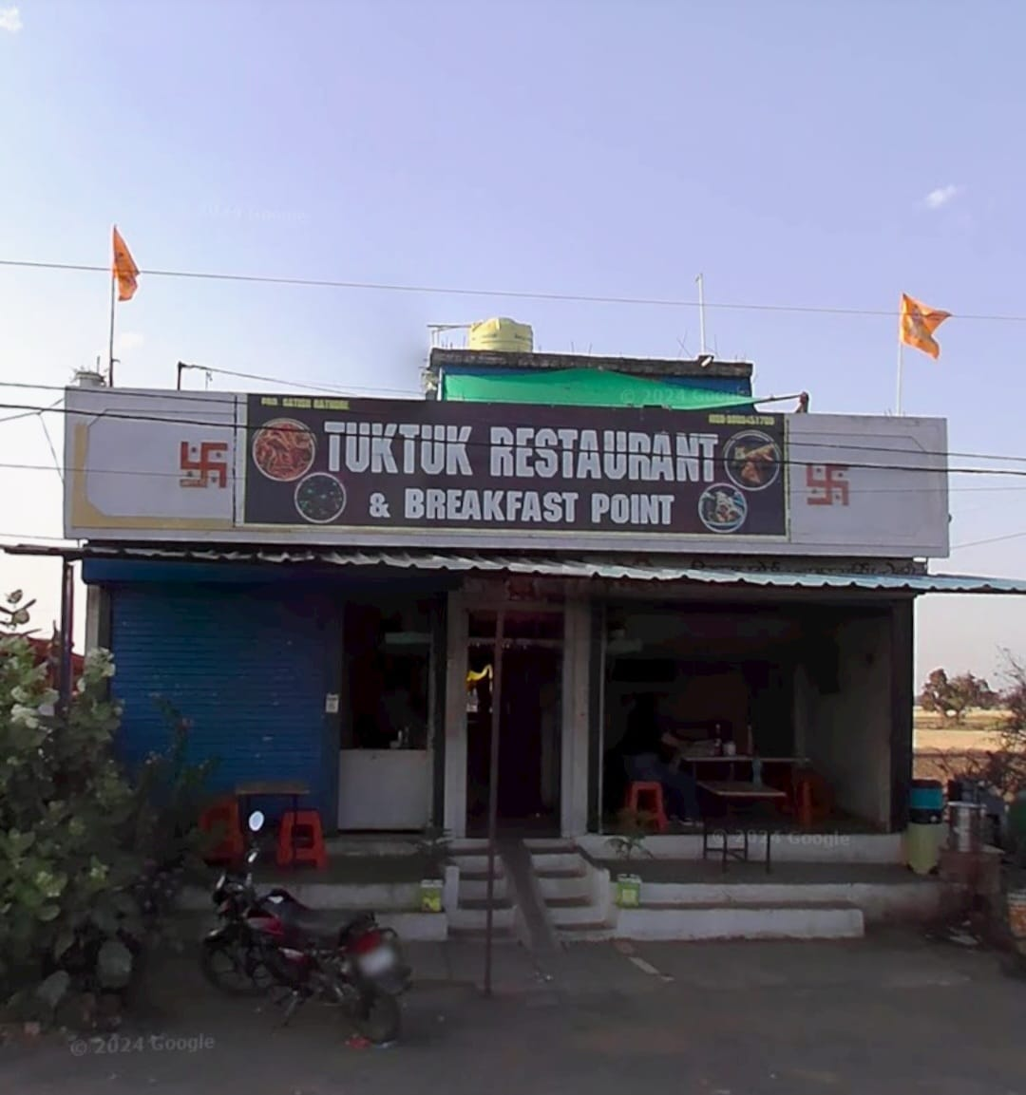
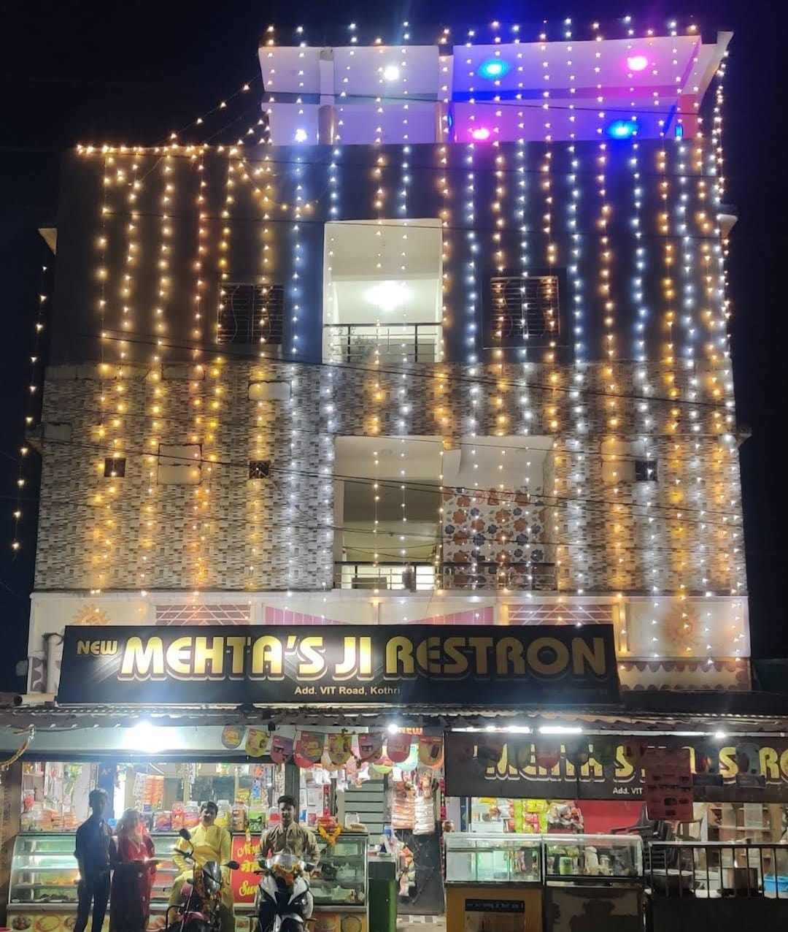

Slide 6
Problem statement
Hostellers: The plight of past possessions
Hostellers, especially Freshers, require basic things like Mattress, Bucket and also cycles for easy movement.
No dedicated service platform to connect the buyer (fresher/hosteller) and seller.
Locals selling at unreasonable rates to students, keeping profits high.
Cycle repair facilities are inconsistent with no regularity in visits by mechanics.
No chain of information to reach everyone.
Final Year Students need to sell their mattresses, other belongings but there is no medium.

Slide 7
SOLUTION for Day Scholars & Hostellers
Website Based Solution
Doorstep food delivery.
Real time updates on shops.
Review & complaint section.
Multi-order options.
Integration of Map View.
Rating system based on quality.
Trust Rating for sellers.
Guarantee based transactions.
How is it relevant?
Online delivery saves time.
Can attract new restaurants to set up business.
Employment opportunities for locals.
Fresher-friendly because of feedback loop.
Hassle free business.
Trustworthy products and options for second hand deals.
How is it better than existing solution?
There are no existing solutions in the first place to compare with our model. So, any efforts made are worthwhile.

Slide 8
Feasibility
Accessibility for user
Internet Connectivity.
Mobile or laptop device.
Expansion of Solution
Integrating Transportation (auto) for faster travel.
Catalogue of available rooms for rent and booking facilities.
Expanding to include tiffin service providers and monthly caterers.
Accessibility for developer
Internet Connectivity.
Laptop device.
IDE and firebase subscription.
Developing skills.
Ideal Customer and their needs
Day Scholars (Food services)
Hostellers (Essential buy/sell services)

Slide 9
Software Used
Frontend:
HTML, CSS, JavaScript: Core web technologies.
Bootstrap: For responsive design.
jQuery: For DOM manipulation and AJAX calls.
Google Maps API: For integrating maps.
Backend:
PHP: Server-side scripting language.
MySQL: Database management system.
Apache: Web server.

Slide 10
User Registration and Authentication: Frontend: Create registration and login forms using HTML. Backend: Use PHP to handle form submissions and store user data in MySQL. Restaurant Listings and Online Ordering: Frontend: Display restaurant listings and menus using HTML and Bootstrap. Backend: Use PHP to retrieve restaurant data from MySQL. Review and Hygiene Rating System: Frontend: Create forms for submitting reviews and displaying ratings using HTML, CSS, and jQuery. Backend: Store reviews and ratings in MySQL and manage them with PHP. Multi-Restaurant Order Handling: Frontend: Allow users to add items to their cart from different restaurants and place orders. Backend: Use PHP to process and store order data in MySQL.
IMPLEMENTATION

Slide 11
Map Integration for Restaurant Locations: Frontend: Integrate Google Maps API to display restaurant locations. Backend: Provide restaurant location data using PHP. Marketplace for Hostel Students: Frontend: Create forms for posting ads and viewing items for sale using HTML, CSS, and jQuery. Backend: Store marketplace data in MySQL and manage with PHP. Scheduler for Cycle Mechanic: Frontend: Create forms for scheduling appointments using HTML, CSS, and jQuery. Backend: Store scheduling data in MySQL and manage with PHP.

Slide 12
THANK YOU

Slide 13


OUR PROUD SPONSOR

